Slide 1
UNIT II- Understanding Cloud Architecture

Slide 2
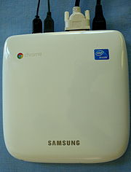
Cloud computing architectures consist of front-end platforms called clients or cloud clients.
These clients comprise servers, fat (or thick) clients, thin clients, zero clients, tablets and mobile devices.
These client platforms interact with the cloud data storage via an application (middleware), via a web browser, or through a virtual session.
The zero or ultra-thin client initializes the network to gather required configuration files that then tell it where its OS binaries are stored.
The entire zero client device runs via the network. This creates a single point of failure, in that, if the network goes down, the device is rendered useless.
Examples: Web browsers,
An online network storage where data is stored and accessible to multiple clients.
Cloud storage is generally deployed in the following configurations: public cloud, private cloud, community cloud, or some combination of the three also known as hybrid cloud.
In order to be effective, the cloud storage needs to be agile, flexible, scalable, multi-tenancy, and secure.
Cloud based delivery- Iaas, Saas or Paas

Slide 3
A typical zero client product is a small box that serves to connect a keyboard, mouse, monitor andEthernet connection to a remote server.
The server, which hosts the client's operating system (OS) and software applications, can be accessed wirelessly or with cable.
Zero clients are often used in a virtual desktop infrastructure (VDI) environment.
Benefits of Thin Clients:
Power usage can be as low as 1/50th of fat client requirements.
Devices are much less expensive than PCs or thin clients.
Efficient and secure means of delivering applications to end users.
No software at the client means that there is no vulnerability to malware.
Easy administration.
In a VDI environment, administrators can reduce the number of physical PCs or blades and run multiple virtual PCs on server class hardware.
Vendors of zero client products include Digi International, Pano Logic Inc., Teradici, Via Labs and Wyse Technology.

Slide 4
Generally, the cloud network layer should offer:
High bandwidth (low latency)
Allowing users to have uninterrupted access to their data and applications.
Agile network
On-demand access to resources requires the ability to move quickly and efficiently between servers and possibly even clouds.
Network security
Security is always important, but when you are dealing with multi-tenancy, it becomes much more important because you're dealing with segregating multiple customers.

Slide 5
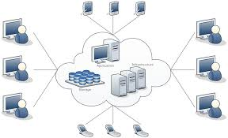
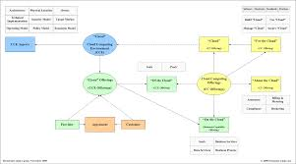
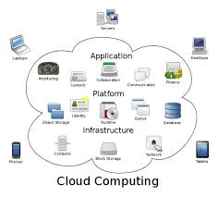
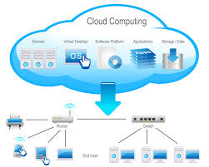

Slide 6
Exploring the Cloud Computing Stack
Based on distributed network applications on the Internet.
N-tiered Internet application coupling software and hardware to provide on-demand service.
Two architectural layers:
A client as a front end, The “cloud” as a backend
Provides encapsulated information controlled using API’s
A cloud architecture can be created using an infrastructure or outsourced to a datacentre.
Mostly uses virtualized resources which are easier to modify and optimize.

Slide 7
Composability
Assembling of resources or components
A composable component must be:
• Modular: It is a self-contained and independent unit that is cooperative, reusable, and replaceable.
• Stateless: A transaction is executed without regard to other transactions or requests.
Modular storage take advantage of the movement toward network storage through consolidation, scalability, performance, availability and a better return on investment.
Currently EMC's Symmetrix, IBM's Enterprise Storage Server (Shark), StorageTek's SVA, and Hitachi Data Systems' Lightning Series provide this large form-factor storage system capable of attaching to mainframes, as well as open systems server environments.

Slide 8
Portable and interoperable solutions easier to implement by the composable design of software and hardware.
But most of the cloud computing solutions follow non std versions.- incorporate cloud computing stack.
Vendors such as Amazon Web Services, GoGrid, or Rackspace, it makes no sense to offer non-standard machine instances to customers, because those customers are almost certainly deploying
applications built on standard operating systems such as Linux,
Windows, Solaris, or some other well-known operating system.
Vendors such as Windows Azure or Google AppEngine may narrow the definition of standard parts to standard parts that work with their own platforms- only to provide modularity.

Slide 9
Highest degree of integration in cloud computing, which is SaaS (Software as a Service), the notion of composability for users may completely disappear.
An SaaS vendor such as Quicken.com or Salesforce.com is delivering an application as a service to a customer but not as a composable service rather a custom application.
Few benefits of composable systems:
Easier to assemble systems
• Cheaper system development
• More reliable operation
• A larger pool of qualified developers
• A logical/reasonable design methodology

Slide 10
Infrastructure
Virtual servers described in terms of a machine image or instance have characteristics that often can be described in terms of real servers delivering a certain number of microprocessor (CPU) cycles, memory access, and network bandwidth to customers.
Virtual machines are containers that are assigned specific resources.
The software that runs in the virtual machines is what defines the utility of the cloud computing system.
Eg: IaaS uses virtual machine technology to run applications on servers like citrixen or vmware or IBM hypervisors.
Figure 3.1 shows the portion of the cloud computing stack that is defined as the “server.” In the diagram, the API is shown shaded in gray because it is an optional component that isn't always delivered with the server.
The VMM component is the Virtual Machine Monitor, also called a hypervisor.
This is the low-level software that allows different operating systems to run in their own memory space and manages I/O for the virtual machines.

Slide 12
Platforms
A platform in the cloud is a software layer that is used to create higher levels of service.
Examples:
Salesforce.com's Force.com Platform
• Windows Azure Platform
• Google Apps and the Google AppEngine
These three services offer all the hosted hardware and software needed to build and deploy Web applications or services that are custom built by the developer within the context and range of capabilities that the platform allows.
Platforms represent nearly the full cloud software stack, missing only the presentation layer that represents the user interface
Constructed from components and services and controlled through the API that the platform provider publishes.

Slide 13
Salesforce.com (stylized as salesforce) a cloud computing company headquartered inSan Francisco, California.
Though its revenue comes from a customer relationship management (CRM) product, Salesforce also tries capitalizing on commercial applications of social networking through acquisition.
As of 2015, it is one of the most highly valued American cloud computing companies with a market capitalization of $50 billion although the company has never turned a GAAP profit since its inception in 1999.
It is listed on the New York Stock Exchange and is a constituent of the S&P 500 index.
SERVICES OFFERED:
Salesforce.com's customer relationship management (CRM) service is broken down into several broad categories: Sales Cloud, Service Cloud, Data Cloud(including Jigsaw), Marketing Cloud, Collaboration Cloud(including Chatter), Analytics Cloud and Custom Cloud (including Force.com), with over 100,000 customers.

Slide 14
Microsoft Azure is a cloud computing platform and infrastructure, created by Microsoft, for building, deploying and managing applications and services through a global network of Microsoft-managed and Microsoft partner hosted datacenters.
It provides bothPaaS and IaaS services and supports many different programming languages, tools and frameworks, including both Microsoft-specific and third-party software and systems.
Azure was announced in October 2008 and released on 1 February 2010 as Windows Azure, before being renamed to Microsoft Azure on 25 March 2014
Build and deploy modern, cross platform web and mobile applications
store, backup and recover your data in the cloud
Use an open and flexible platform

Slide 15
Google App Engine (often referred to as GAE or simply App Engine) is a platform as a service (PaaS) cloud computing platform for developing and hosting web applications in Google-managed data centers.
Applications are sandboxed and run across multiple servers.
App Engine offers automatic scaling for web applications—as the number of requests increases for an application, App Engine automatically allocates more resources for the web application to handle the additional demand.
Google App Engine is free up to a certain level of consumed resources.
Fees are charged for additional storage, bandwidth, or instance hours required by the application.
It was first released as a preview version in April 2008 and came out of preview in September 2011.

Slide 16
Platforms represent nearly the full cloud software stack, missing only the presentation layer that represents the user interface.
This is the same portion of the cloud computing stack that is a virtual appliance and is shown in Figure 3.2.
What separates a platform from a virtual appliance is that the software that is installed is constructed from components and services and controlled through the API that the platform provider publishes.
A virtual appliance is software that installs as middleware onto a virtual machine.

Slide 17
A virtual appliance is software that installs as middleware onto a virtual machine- a platform
In computing, a virtual machine (VM) is an emulation of a particular computer system.
Virtual machines operate based on the computer architecture and functions of a real or hypothetical computer, and their implementations may involve specialized hardware, software, or a combination of both.
A virtual machine (VM) is an operating system OS or application environment that is installed on software which imitates dedicated hardware.
The end user has the same experience on a virtual machine as they would have on dedicated hardware.

Slide 18
A virtual appliance is a pre-configured virtual machine image, ready to run on a hypervisor;
virtual appliances are a subset of the broader class of software appliances.
Installation of a software appliance on a virtual machine and packaging that into an image creates a virtual appliance.
Like software appliances, virtual appliances are intended to eliminate the installation, configuration and maintenance costs associated with running complex stacks of software.
A virtual appliance is not a complete virtual machine platform, but rather a software image containing a software stack designed to run on a virtual machine platform which may be a Type 1 or Type 2 hypervisor.
Like a physical computer, a hypervisor is merely a platform for running an operating system environment and does not provide application software itself.
Many virtual appliances provide a Web page user interface to permit their configuration.
A virtual appliance is usually built to host a single application; it therefore represents a new way to deploy applications on a network.

Slide 19
Azure virtual machines (VMs) can be created through the Azure portal.
This method provides a browser-based user interface to create VMs and their associated resources.
This quickstart shows you how to use the Azure portal to deploy a virtual machine (VM) in Azure that runs Windows Server 2022 Datacenter.
To see your VM in action, you then RDP to the VM and install the IIS web server.

Slide 20
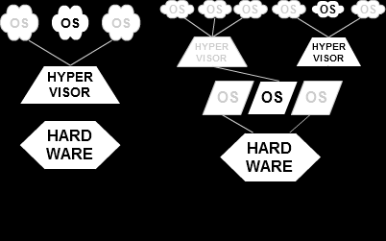
A hypervisor or virtual machine monitor (VMM) is a piece of computer software, firmware or hardware that creates and runs virtual machines.
A computer on which a hypervisor is running one or more virtual machines is defined as a host machine.
Each virtual machine is called a guest machine.
Type-1: native or bare-metal hypervisors
These hypervisors run directly on the host's hardware to control the hardware and to manage guest operating systems. For this reason, they are sometimes called bare metal hypervisors. A guest operating system runs as a process on the host.
Type-2: hosted hypervisors
These hypervisors run on a conventional operating system just as other computer programs do. Type-2 hypervisors abstract guest operating systems from the host operating system. VMware Workstation, VMware Player and VirtualBox are examples of type-2 hypervisors.

Slide 21
Server virtualization uses virtual machines (VMs) to segment a single physical computer server into multiple logical virtual servers.
In many environments, collapsing multiple overpowered physical servers onto a single server running multiple VMs can reap significant economic rewards.
A single server consumes less power, takes up less space, may be easier to manage, and allows for the dynamic creation and removal of VMs on demand.
VMs can be used inside an enterprise IT department or on public clouds, such as Amazon's EC2.
They can move from one physical or geographical location to another using a variety of tools and technologies, such as Rightscale's Cloud Management Platform or VMware's VMotion.
Yet unfortunately, when a VM moves from one location to another, it becomes dependent on the networking infrastructure of the physical appliances attached to the new location.

Slide 22
Internet Information Services (IIS, formerlyInternet Information Server) is an extensible web server created by Microsoft for use with Windows NT family. IIS supports HTTP, HTTPS, FTP, FTPS, SMTP and NNTP.
IIS 10 is included in Windows Server 2016 and Windows 10. This version includes support for HTTP/2
Anonymous authentication
Basic access authentication
Digest access authentication
Integrated Windows Authentication

Slide 23
Five Best Virtual Machine Applications
Virtual machines allow you to run one operating system emulated within another operating system. Your primary OS can be Windows 7 64-bit, for example, but with enough memory and processing power, you can run Ubuntu and OS X side-by-side within it.
The five most popular picks.
Sun
Qemu linux
Windows virtual pc
Mac

Slide 24
Microsoft Azure /ˈæʒər/ is a cloud computing platform and infrastructure, created byMicrosoft, for building, deploying and managing applications and services through a global network of Microsoft-managed and Microsoft partner hosted datacenters.
It provides bothPaaS and IaaS services and supports many different programming languages, tools and frameworks, including both Microsoft-specific and third-party software and systems.
Virtual machines[edit]
Windows Azure virtual machines comprise the infrastructure as a service (IaaS) offering from Microsoft for their public cloud.
Virtual machines enable developers to migrate applications and infrastructure without changing existing code and can run both Windows Serverand Linux virtual machines.
It was announced in preview form at the Meet Windows Azure event in June 2012.^{[2]}
Customers can create virtual machines, of which they have complete control, to run in Microsoft's data centers. As of the preview the virtual machines supported Windows Server 2008 and 2012 operating systems and a few distributions of Linux. The General Availability version of Virtual Machine was released in May 2013.

Slide 25
In IIS, you can create sites, applications, and virtual directories to share information with users over the Internet, an intranet, or an extranet.
Although these concepts existed in earlier versions of IIS, several changes in IIS 7 and above affect the definition and functionality of these concepts.
Most importantly, sites, applications, and virtual directories now work together in a hierarchical relationship as the basic building blocks for hosting online content and providing online services.

Slide 26
Applications
Although the cloud computing stack encompasses many details that describe how clouds are constructed, it is not a perfect vehicle for expressing all the considerations that one must account for in any deployment.
The Internet was designed to treat each request made to a server as an independent transaction.
Therefore, the standard HTTP commands are all atomic in nature: GET to read data, PUT to writedata, and so on.
Design of Internet protocols & HTTP as a stateless service is one reason.
In computing, a stateless protocol is a communications protocol that treats each request as an independent transaction that is unrelated to any previous request so that the communication consists of independent pairs of request and response.
A stateless protocol does not require the server to retain session information or status about each communications partner for the duration of multiple requests.

Slide 27
While stateless servers are easier to architect and stateless transactions are more resilient and can survive outages, much of the useful work that computer systems need to accomplish are stateful.
Here's the classic example. When you go to a reservation system to purchase something, you query inventory, reserve the item, and then pay for it.
In a multiuser system, if you don't have a stateful system, you cannot know whether the item you reserved has already been taken by another user before you can enter your payment for the item.
Should you decide you don't want the item at some later time, it is much easier to restore the item to inventory and return payments or make other adjustments if you can roll back all the steps as a transactional unit.

Slide 28
The development of transaction servers, message queuing servers, and other middleware is meant to bridge this problem.
Cloud computing is no exception to this problem, and to an extent it amplifies the problem by not only making transactions stateless but also virtualizing resources so transactions are always occurring in physically different locations.
In cloud computing, a variety of constructs are brought to bear to solve these issues, but these are the two most important concepts:
The notion of orchestration—that process flow can be choreographed as a service
The use of what is referred to as a service bus that controls cloud components
These are the methods for establishing transactional integrity in cloud computing.

Slide 29
Connecting to the Cloud
Clients can connect to a cloud service in a number of different ways.
These are the two most common means:
A Web browser
A proprietary application
These applications can be running on a server, a PC, a mobile device, or a cell phone.
What these devices have in common with either of these application types is that they are exchanging data over an inherently insecure and transient medium.
There are three basic methods for securely connecting over a connection:
Use a secure protocol to transfer data such as SSL (HTTPS), FTPS, or IPsec, or connect using a secure shell such as SSH to connect a client to the cloud.
Create a virtual connection using a virtual private network (VPN), or with a remote data transfer protocol such as Microsoft RDP or Citrix ICA, where the data is protected by a tunnelling mechanism.
Encrypt the data so that even if the data is intercepted or sniffed, the data will not be meaningful.

Slide 30
The best client connections use two or more of these techniques to communicate with the cloud.
In current browser technology, clients rely on the Web service to make available secure connections, but in the future, it is likely that cloud clients will be hardened so the client itself enforces a secure connection.
Other solutions include using VPN software; here are three recommended solutions:
Hotspot VPN (http://www hotspotvpn.com/)
AnchorFree Hotspot Shield (http://hotspotshield.com/)
Gbridge (http://www.gbridge.com/), a third-party VPN based on Google's GoogleTalk infrastructure.
Gbridge is an interesting solution that illustrates the use of VPN over a cloud connection.

Slide 31
To use this product, you need to log into the GoogleTalk (or Gtalk) network and connect to another computer using your Google account.
Gbridge allows additional people to join a connection when invited and supports collaborative features such as desktop sharing using the Virtual Network Computing (VNC) software, chat, live folder browsing, folder synchronization, and automated backup.

Slide 32
Gbridge provides a means for securely connecting one computer to another using Gtalk. Shown here is the SecureShares folder-browsing feature.

Slide 33
The Jolicloud cloud client operating system is a social networking platform for netbooks with a dedicated application store.

Slide 34
..\cloud-computing-bible.pdf

Slide 35
Understanding Service Oriented Architecture
Service Oriented Architecture (SOA) describes a standard method for requesting services from distributed components and managing the results.
With SOA, clients and components can be written in different languages and can use multiple messaging protocols and networking protocols to communicate with one another.
SOA provides the standards that transport the messages and makes the infrastructure to support it possible.
SOA provides access to reusable Web services over a TCP/IP network, which makes this an important topic to cloud computing going forward.
Monolithic cloud applications like backup, e-mail, Web page access, or instant messaging
If additional services are required, SOA offers access to ready-made, modular, highly optimized, and widely shareable components that can minimize developer and infrastructure costs.

Slide 36
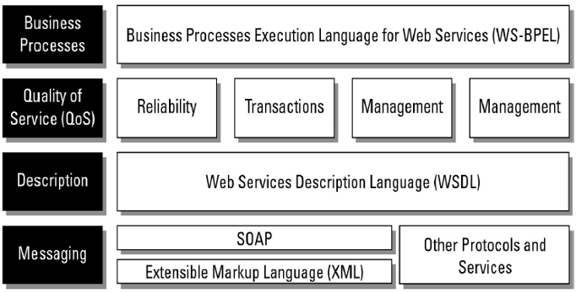
The environment SOA creates is a virtual message-passing system with a loose coupling between clients and services.
The specification of the manner in which messages are passed in SOA, or in which events are handled, are referred to as their contract

Slide 37
Few scenarios….
For example, the system identifies my location via GPS and can provide me with information via a personalized localization.
Using the integrated camera one can scan a barcode and run a price comparison through the system.
How to go for optimized processes/cost?
Many will look for these by default:
location-based services, social networks, mobile search, mobile commerce, mobile cash, context-aware services, object recognition, mobile instant messaging, mobile e-mail, and mobile video.

Slide 38
Typically, SOA requires the use of an orchestrator or broker service to ensure that messages are correctly transacted.
SOA makes no other demands on either the client (consumer) or the components (provider) of the service; it is concerned only with the interface or action boundary between the two.
Service and Data Contract:
Service contract is an interface that defines the message types used by service providers and consumers to exchange messages.
Data contract is a formal agreement between service and a client that abstracts the definition of data to be exchanged.
During service call- a service consumer invokes the operations specified in a service contract and exchanges data as per the data contract
GST –service contract
Online transaction- net banking uses billing info very securely- data contract

Slide 39
Enterprise Service Bus –takes care of transformation of functions and routing between service providers and consumers.
Web services are SOAP (XML over HTTP which is machine readable) and RESTful (JSON/XML/XHTML over HTTP which is human readable)
APIs are needed for RESTful services.

Slide 40
Components are coded with their service logic and their dependencies, QoS is established, and the service is instantiated.
In the SCA (Servcie Component Architecture) model, data and messages are exchanged in a Service Data Object (SDO).
This system of messaging using objects and services is sometimes referred to as a Data Access Service (DAS).
Figure 13.2 shows how components of different types can communicate using different protocols as part of SOA.

Slide 41
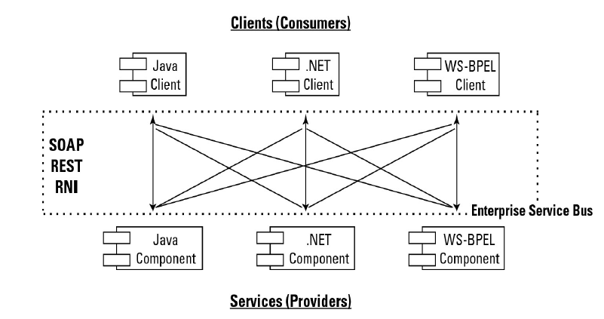
SOA allows for different component and client construction, as well as access to each using different protocols.
When you combine Web services to create business processes, the integration must be managed.
Two main methods are used to combine Web services: orchestration and choreography.
In orchestration, a middleware service centrally coordinates all the different Web service operations, and all services send messages and receive messages from the orchestrator.
The logic of the compound business process is found at the orchestrator alone. Figure 13.3 shows how orchestration is managed.
Eg: WebLogic. Web Sphere, Kafka, HTTP, Apache Tomcat, WebSocket, Liberty servers

Slide 42
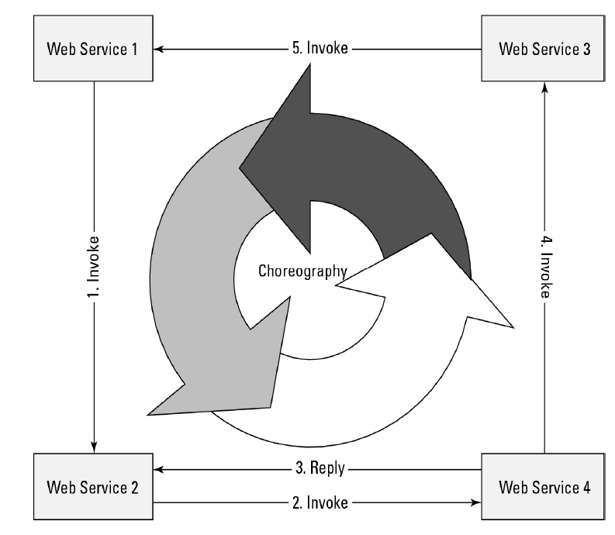
In choreography, each Web service that is part of a business process is aware of:
when to process a message and ??
with what client or component it needs to interact with??
Choreography is a collaborative effort where the logic of the business process is pushed out to the members who are responsible for determining which operations to execute and when to execute them, the structure of the messages to be passed and their timing, and other factors. Figure 13.4 illustrates the nature of choreography.

Slide 43
Choreography is different from orchestration, which is a centralized approach where a single service governs the interactions between all services.
Execution of distributed services using specific logic is choreography.
In orchestration, a controller process calls each service involved in a transaction, monitors the results, and then calls the next service or performs a rollback.

Slide 44
Netflix is an example of a web service that uses choreography in its microservices architecture.
Choreography is an event-driven approach where services react independently to events or messages.
In Netflix's case, each microservice operates independently and communicates via events.
For example, when a new movie is added, the content service publishes an event that the recommendation service consumes to update user recommendations.

Slide 45
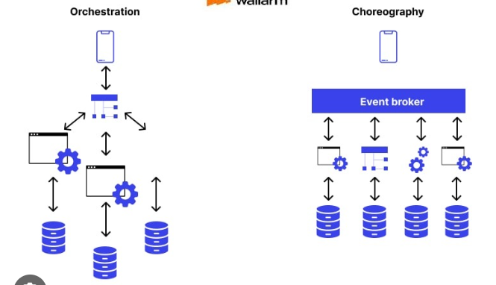

Slide 46
Drivers for SOA
Business:
Rapid business process changes
Reduction of process cycle times
Promotion of business through multiple channels
Protection of investments in legacy applications
Lower total cost of ownership.
Technology:
Application modernization
Technology change management
Integration and interoperability for heterogeneous applications
Support by product vendors

Slide 47
Dimensions of SOA
To enable business transformation are:
Reuse- build once and use many times
Integration – stitching components to automate execution of process
Agility- connects to external components through configuration
Additional dimensions:
Governance – define policies that services need to adhere to at design/runtime.
QoS- is to monitor and enforce policies at runtime.

Slide 48
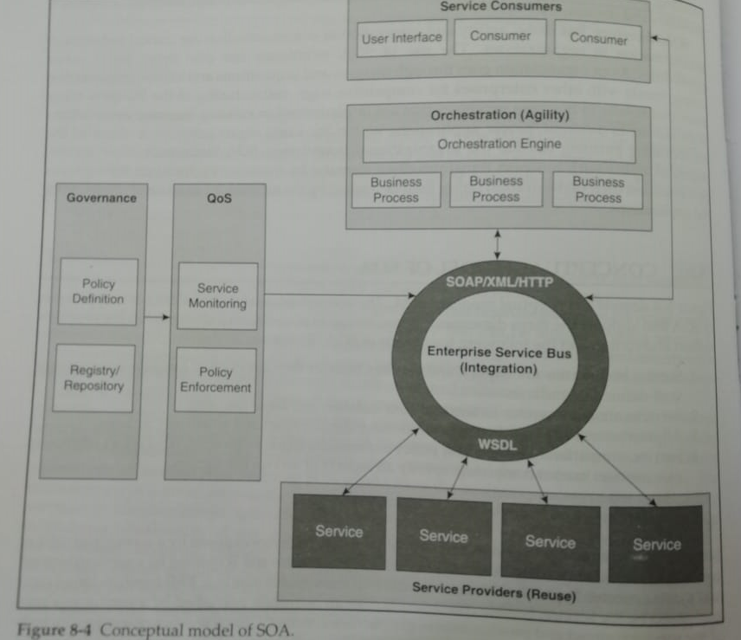
Conceptual model of SOA

Slide 49
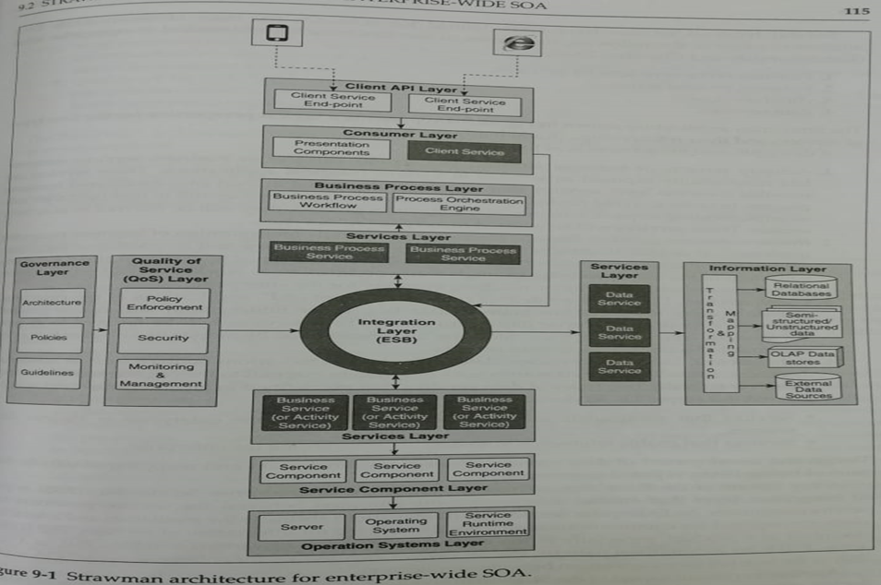

Slide 50
Event-driven SOA or SOA 2.0
Event-driven SOA or SOA 2.0 is an extension of the Service Oriented Architecture to respond to events that occur as a result of business processes or perhaps cause and influence a business process.
For example, in a business process, sales at a certain Web site are processed.
If the business process recognizes the rate at which sales are occurring, it could perform an analysis to determine what events might influence the buying decision.
This is the sort of analysis that event-driven SOA is meant to address.
SOA 2.0 can allow low-level events to trigger a business process, correlate events with information contained in the SOA design, inhibit a business process if the appropriate events don’t appear, or invoke a reaction or response based on a trigger.

Slide 51
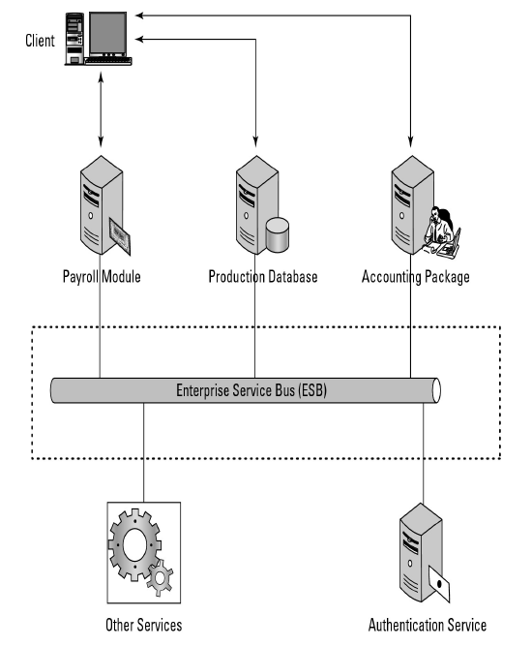
The Enterprise Service Bus
Architectural pattern- broker between service provider and consumer.
Integration task through routing content and transformation.
Orchestration and choreography-set of services for a business process, defining workflow, BPEL , process level integration and automation of services.
ESB performs message translation, registration, routing, logging, auditing, and managing transactional integrity.
Transactional integrity is similar to ACID in a database system—atomicity, consistency, isolation, and durability, the essence of which is that transactions succeed or they fail and are rolled back.

Slide 52
These typical features are found in ESBs, among others:
• Monitoring services aid in managing events.
• Process management services manage message transactions.
• Data repositories or registries store business logic and aid in governance of business processes.
• Data services pass messages between clients and services.
• Data abstraction services translate messages from one format to another, as required.
• Governance is a service that monitors compliance of your operations with governmental
regulation, which can vary from state to state and from country to country.
• Security services validate clients and services and allow messages to pass from one to the other.

Slide 53
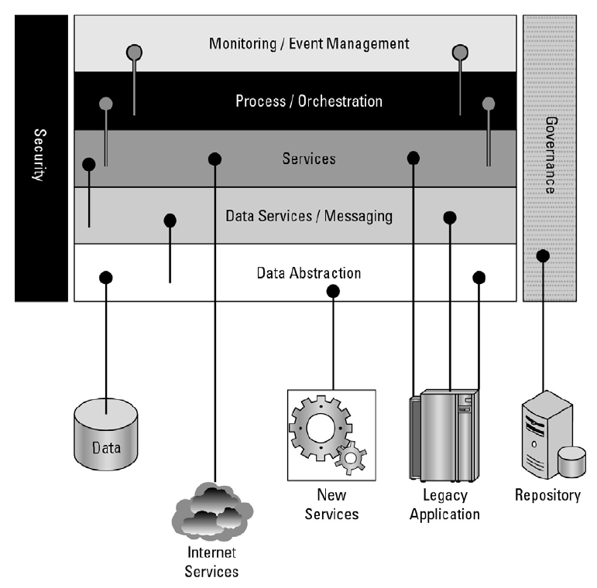
This figure shows a network services model infrastructure for an SOA, which is based on the SOA meta-model of the Linthicum Group, 2007.

Slide 54
Service catalogs
SOA infrastructure often includes a catalog service. This service stores information on the following, among other things:
• What services are available, both internal and external
• How to use a service
• Which applications are related to a particular service (dependencies)
• How services relate to one another
• Who owns the service and how a service is modified
• The event history of a service, including service levels, outages, and so on
• The nature of service contracts

Slide 55
Defining SOA Communications
Message passing in SOA requires the use of two different protocol types:
the data interchange format
and the network protocol that carries the message.
A client (or customer) connected to an ESB communicates over a network protocol such as HTTP, Representational State Transfer (REST), or Java Message Service (JMS) to a component (or service).
Messages are most often in the form of the eXtensible Markup Language (XML) or in a variant such as the Simple Object Access Protocol (SOAP) or JSON.
SOAP is a messaging format used in Web services that use XML as the message format while relying on Application layer protocols such as HTTP and Remote Procedure Calls (RPC) for message negotiation and transmission

Slide 56
The software used to write clients and components can be written in Java, .NET, Web Service Business Process Execution Language (WS-BPEL), or another form of executable code; the services that they message can be written in the same or another language.
What is required is the ability to transport and translate a message into a form that both parties can understand.
An ESB may require a variety of combinations in order to support communications between a service consumer and a service provider.
For example, in WebSphere ESB, you might see the following combinations:
• XML/JMS (Java Message Service)
• SOAP/JMS
• SOAP/HTTP
• Text/JMS
• Bytes/JMS

Slide 57
WSDL
The Web Service Description Language (WSDL) is one of the most commonly used XML protocols for messaging in Web services.
Version 1.1 of WSDL is a W3C standard, but the current version WSDL 2.0 (formerly version 1.2) has yet to be ratified by the W3C.
The significant difference between 1.1 and 2.0 is that version 2.0 has more support for RESTful (e.g. Web 2.0) application, but much less support in the current set of software development tools.
The most common transport for WSDL is SOAP, and the WSDL file usually contains both XML data and an XML schema.

Slide 58
REST
REST offers some very different capabilities than SOAP.
With REST, each URL is an object that you can query and manipulate.
You use HTTP commands such as GET, POST, PUT, and DELETE to work with REST objects.
SOAP uses a different approach to working with Web data, exposing Web objects through an API and transferring data using XML.
The REST approach offers lightweight access using standard HTTP command, is easier to implement than SOAP, and comes with less overhead.
SOAP is often more precise and provides a more error-free consumption model.
SOAP often comes with more sophisticated development tools.
All major Web services use REST, but many Web services, especially newer ones, combine REST with SOAP to derive the benefits that both offer.

Slide 59
Managing and Monitoring SOA
For large SOA deployments
Tools for managing SOAs tend to be multifaceted and run constantly.
SOA management tools:
HP Software and Solutions OpenView SOA Manager
(https://h10078.www1 hp.com/cda/hpms/display/main/hpms content.jsp?zn=bto&cp=1-10^36657
4000 100)- provides dynamic mapping, monitoring, and optimization of SOA services such as Web services, software assets, and virtual services
IBM Tivoli Framework Composite Application Manager for SOA (ITCAM; see
http://www-01.ibm.com/software/tivoli/solutions/)- specializes in change management and SOA lifecycle development, and it integrates with a WebSphere and others.
Oracle BPEL Process Manager (http://www.oracle.com/technology/bpel/index html)- process managers for creating an Enterprise Service Bus.

Slide 60
SOA security
Network traffic is hijacked, spoofed, redirected, or blocked.
No Application boundaries in SoA
To address these issues products in the market are:
Cisco has a family of products that enforce rules and policies for the transmission of XML messaging that they have named Application Oriented Networking (AON; http://www.cisco.com/en/US/products/ps6480/).
A similar policy-based XML security service may be found in Citrix's NetScaler 9.0 (http://www.citrix.com/English/ps2/products/product.asp?contentID=21679) Web application delivery appliance.

Slide 61
To address SOA security, a set of OASIS standards (http://www.oasis-open.org/committees/tc home.php?wg abbrev=security) was created, which includes the following:
Security Assertion Markup Language (SAML) is an XML standard that provides for data authentication and authorization between client and service. The SAML technology is used as part of Single Sign-on Systems (SSO) and allows a user logging into a system from a Web browser to have access to distributed SOA resources.
WS-Security (WSS) is an extension of SOA that enforces security by applying tokens such as Kerberos, SAML, or X.509 to messages. Through the use of XML Signature and XML Encryption, WSS aims to offer client/service security.
WS-SecureConversion is a Web services protocol for creating and sharing security context. WS-SecureConversion is meant to operate in systems where WS-Security, WS-Trust, and WS-Policy are in use, and it attaches a security context token to communications such as SOAP used to transport messages in an SOA enterprise.
WS-SecurityPolicy provides a set of network policies that extend WS-Security, WS-Trust, and WS-SecureConversion so messages complying to a policy must be signed and encrypted. The SecurityPolicy is part of a general WS-Policy framework.
WS-Trust extends WS-Security to provide a mechanism to issue, renew, and validate security tokens. A Web service using WS-Trust can implement this system through the use of a SecurityToken Service (STS), a mechanism for attaching security tokens to messages and a set of mechanisms for key exchanges that are used to validate tokens and messages.

Slide 62
The Open Cloud Consortium
The Open Cloud Consortium (OCC; see http://opencloudconsortium.org/) is an organization comprised of several universities and interested companies that supports the development of standards for cloud computing and for interoperating with the various frameworks.
Functions of OCC:
They develop benchmarks for measuring cloud computing performance
They provide testbeds that vendors can use to test their applications, including the Open Cloud Testbed and the Intercloud Testbed that are part of the work of the Open Cloud Testbed and Intercloud working groups
They support the development of open-source reference implementations for cloud computing. For Large Data Clouds extends the architecture for data storage with a distributed file system, table services, and computing using MapReduce following the model that is part of Google's offering.
Eg: MapReduce, Apache Hadoop

Slide 63
Relating SOA and Cloud Computing
Applications of big scale types have less of a need for the flexibility and loose coupling that SOA provides. As cloud applications become more diverse in scope; SOA offers an architectural blueprint for accessing diverse optimized services through a loosely coupled standardized method.
SOA is loosely coupled because the service is separated from the messaging.
SOA components are often best-of-breed service providers that can provide a measured service level and can play a role in Business Process Management (BPM) systems. The separation of services from their design allows for much easier system upgrades and maintenance.
Many Web 2.0 applications use SOA components, and SOA will become increasingly useful in larger applications that require many Web services. Eg: REST and AJAX.
A mashup is the combination of data from two or more sources that creates a unique service. The layers added to Google maps are examples of mashups.
SoA- Inetrnet of Services (IoS)

Slide 64
UNIT –II completed

